Slide 1
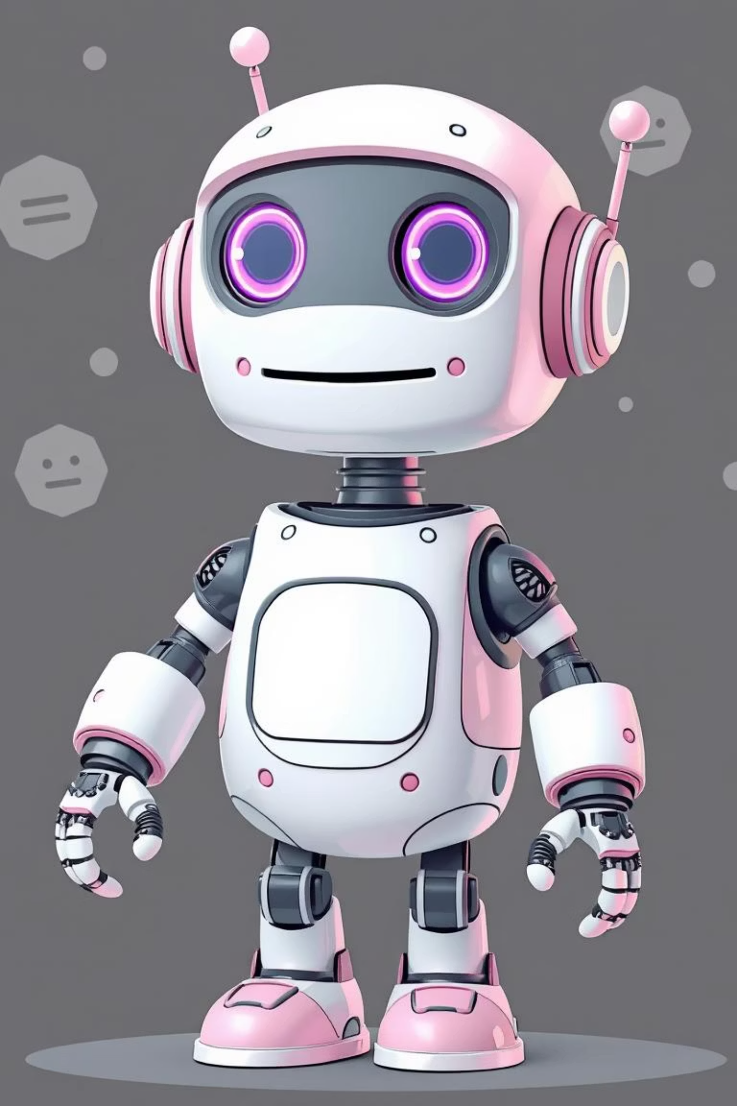
Internal FAQ Bot - AI-Powered Documentation Assistant
Revolutionizing Knowledge Sharing by (HBPS)
Project Name: Internal FAQ Bot
Category: Knowledge Sharing
Hackathon: Blackbucks × Mahindra Hackathon 2025
Team: 5 Members.
Tagline: "From Documentation Chaos to Instant Answers"

Slide 2
The Documentation Challenge
Wasted Time
Information Silos
Onboarding Pain
Developers lose 20-30 mins daily searching docs
Critical knowledge buried in lengthy documents
New hires struggle to find answers quickly
Our solution reduces search time from 30 minutes to 30 seconds

Slide 3
Built with Modern Technologies
Frontend
Backend
React.js UI for dynamic, responsive user interface
Node.js and Express.js for robust API server
Tailwind CSS for modern, clean styling
OpenAI GPT API for intelligent natural language processing
Component-based architecture for scalability
RESTful API design for seamless integration

Slide 4
Intelligent Query Processing
Smart Response
AI Analysis
Generates contextual, accurate answers
User Question
GPT API analyzes query context and intent Searches through company documentation database Identifies relevant information and code examples
Developer asks via web or Slack
Includes code snippets, examples, and best practices
Support for file uploads and document references
Provides source references and related documentation links

Slide 5
Our Collaborative Team
1
2
3
Frontend
AI Integration
Backend
Safdar & Harpith built React UI
Pranav handled GPT implementation
Bharath & Punith designed database and Backend
Responsibilities: User interface design, responsive layouts, component architecture
Knowledge base structure, API endpoints, data management

Slide 6
Measurable Impact
90%
2s
24/7
Reduction in search time
Average response time
Global availability

Slide 7

Future Vision
Integration with more platforms (Microsoft Teams, Discord)
Advanced analytics and usage insights
Multi-language support for global teams
Voice query capabilities
Integration with existing documentation platforms (Confluence, Notion)

Slide 8


From Chaos to Instant Answers
"We transform scattered documentation into intelligent answers - because great developers deserve great tools."

